Slide 1


SMART LOGISTICS SOLUTIONS
Predicting Stock Demand & Delivery Volume Trends
Advanced Time Series Forecasting | June 2026

Slide 2

Project Overview & Business Problem

Slide 3

Reactive Logistics is Costly
The Complication
The Resolution
Fluctuating delivery volumes and unpredictable stock demand lead to warehouse inefficiencies, high labor costs during spikes, and stockouts during peak periods.
Implement a dual-model forecasting system (Prophet & ARIMA) to automate restocking schedules and labor allocation based on high-fidelity time-series insights.

Slide 4
500-Day Historical Data Foundation
Robust Data Baseline
Our model utilizes a synthetic dataset of 500 records, modeling real-world logistics complexities including:
•
Gradual upward growth trend (0.15% daily)
•
Strict weekly seasonal variations
•
Mid-month "payday" delivery surges
•
Standard operational white noise

Slide 5
Weekly Seasonality Drives Spikes
Decomposition Insights
Time series decomposition isolates the three core drivers of logistics volume:
Trend: Consistent long-term business growth.
Seasonality: Monday-Friday peaks vs. weekend drops.
Residuals: Unpredictable day-to-day variance.

Slide 6
Forecasting Methodology & Model Benchmarking

Slide 7
Prophet Exhibits 3x Higher Accuracy
Superior Error Reduction
Mean Absolute Error (MAE) comparison demonstrates that Meta Prophet captures seasonal dips significantly better then the standard ARIMA.

Slide 8
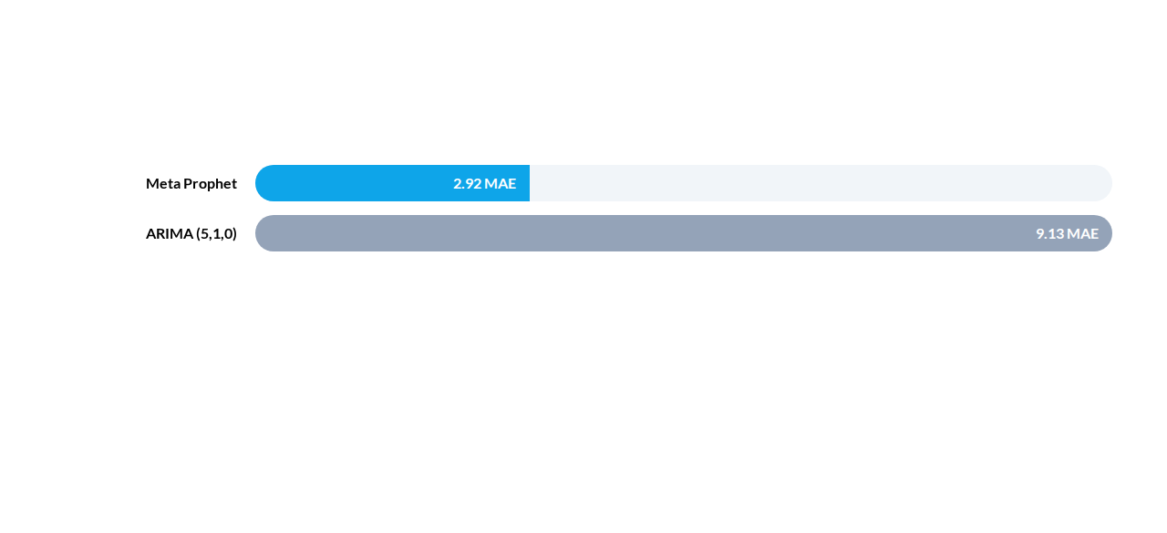
Statistical Benchmarking Results
Note: Lower MAE values indicate higher forecasting precision. Prophet's advantage lies in its explicit seasonal modeling.

Slide 9





Prophet is the Operational Choice
Seasonal Fidelity
Robustness
Deployment
Preserves 7-day zigzag patterns deep into the 30-day forecast window, unlike ARIMA which tends to flatten.
Effectively handles missing data and outliers without requiring complex pre-processing or stationarity checks.
Standardized 'ds' and 'y' column structure allows for rapid integration into existing business dashboards.

Slide 10
Scaling Future Logistics
Strategic demand planning for May 2026 indicates a requirement for increased buffer capacity. Our "Safety Threshold" analysis suggests an immediate calibration is needed to support 700+ unit peaks.
Projected Peak Demand: ~700 Units

Slide 11
Warehouse Operational Dashboard
Metric Type | Value / Target | Recommendation | Status
Avg Daily Demand | 645.20 Units | Maintain Baseline Staffing | Normal
Peak Forecasted Spike | 698.45 Units | Overtime Shift Required
Total Inventory (30D) | 19,356.12 Units | Consolidate Supplier Orders | Healthy
Safety Threshold | 625.00 Units | Upgrade from 540 | Optimizing

